Slide 1

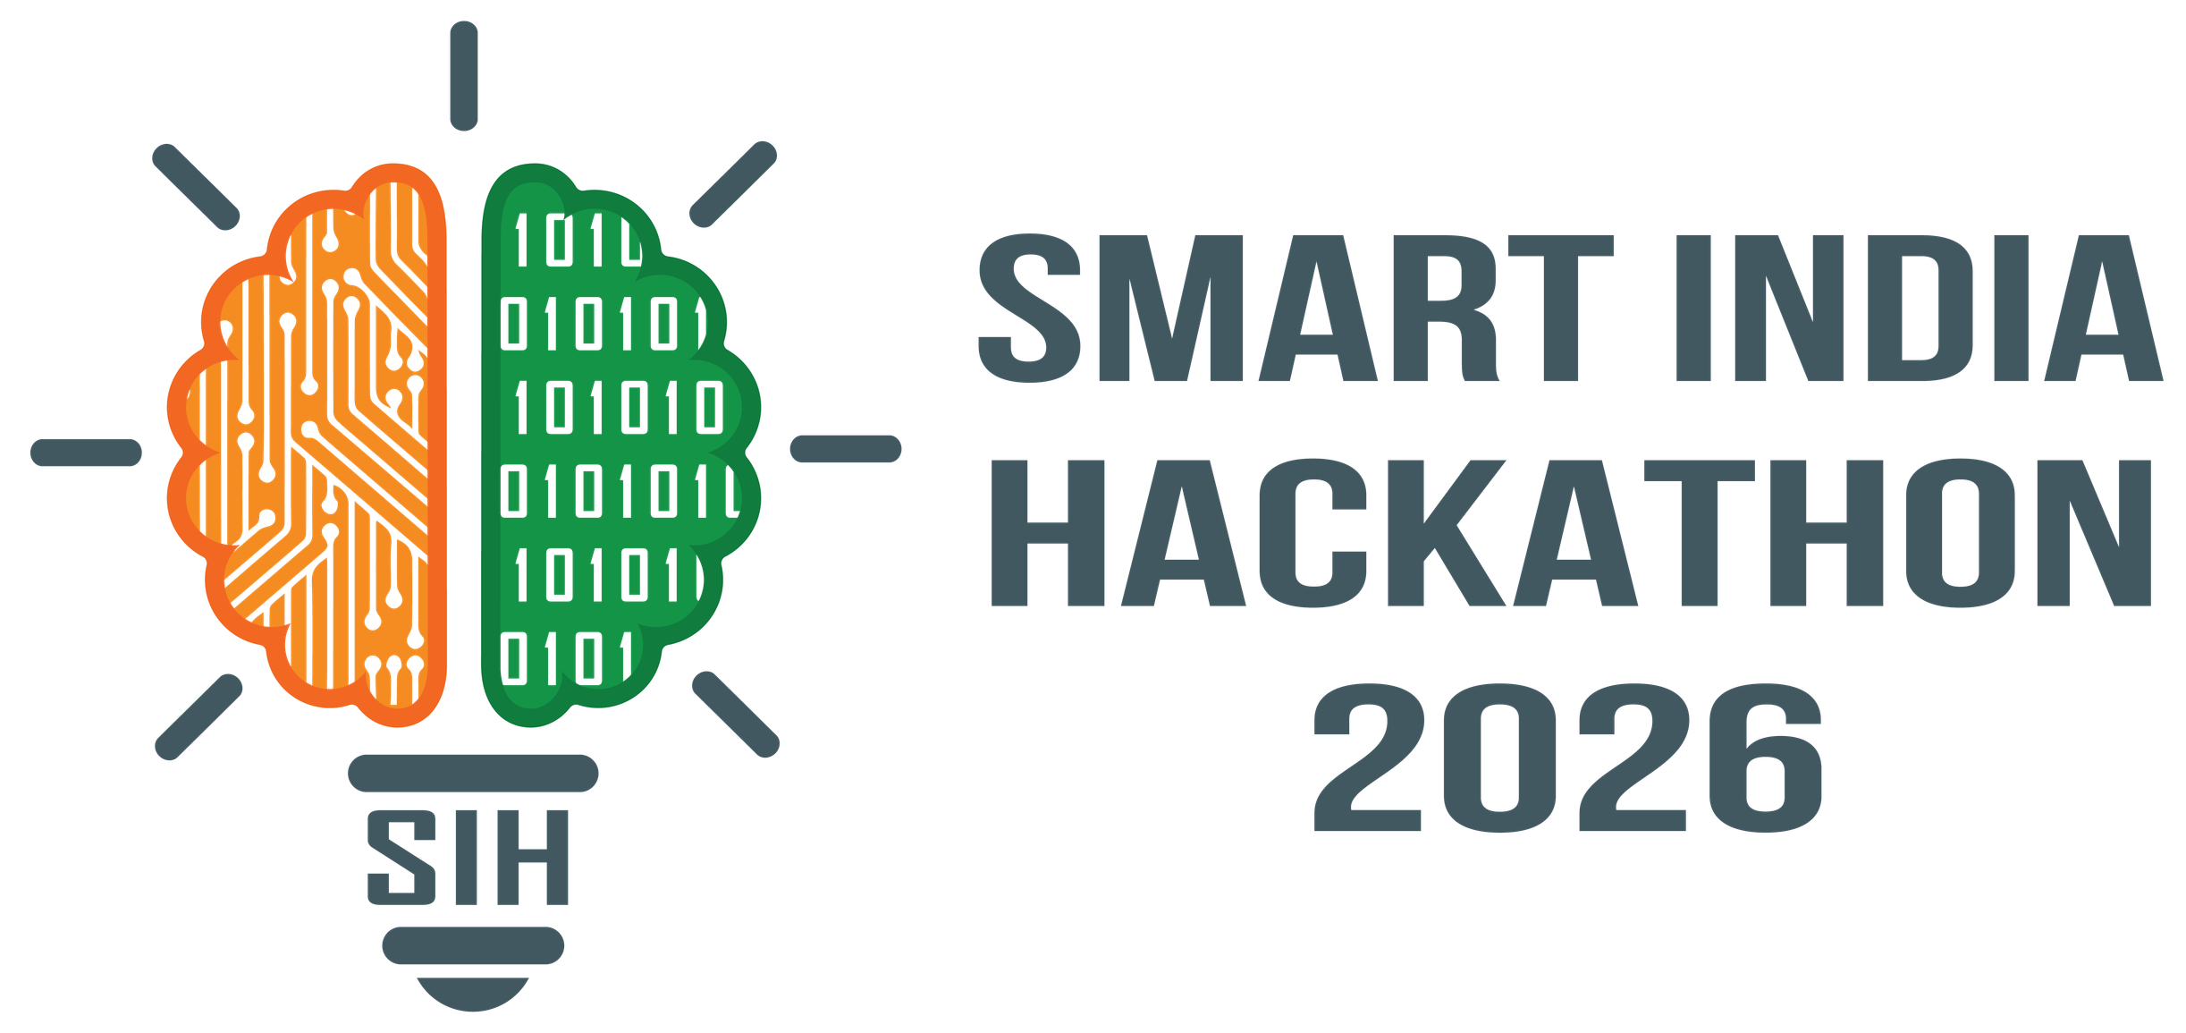

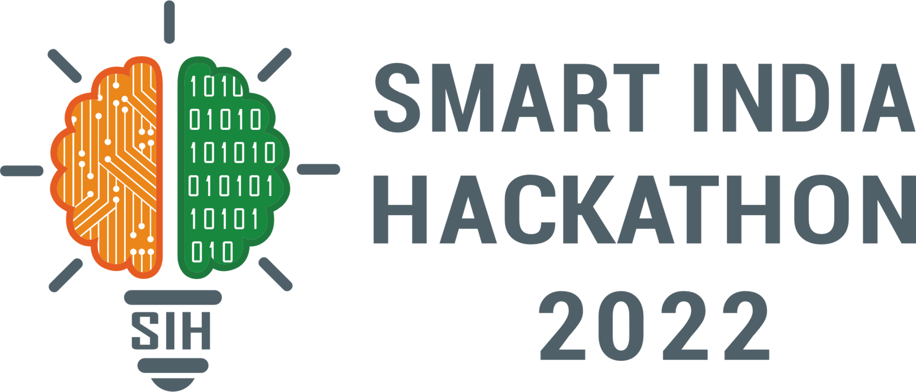
SMART INDIA HACKATHON 2026
Problem Statement ID - SIH26117
Problem Statement Title - Sovereign On-Premise Agentic AI Workbench Using Open - Weight Multimodal LLms for Confidential Industrial Work.
Theme - Smart Automation
PS Category - Software
Team ID -
Team Name - Tech Udaan

Slide 2


TECH
UDAAN
SOVEREIGN ON-PREMISE AI WORKBENCH
1
Proposed Solution
1
1
User Portal
Requests, documents & reports come in
AI Orchestrator — Plans tasks and manages multi-agent execution.
Local AI Stack — Self-hosted LLMs, VLMs & embedding models.
Hybrid Knowledge Layer — RAG + Knowledge Graphs for grounded reasoning.
2
AI Orchestrator & Agents
Plans, coordinates & executes with human approval
3
Local AI + Knowledge Layer
Self-hosted models + RAG / Knowledge Graph
2
How It Addresses the Problem
1
3
CONTINUOUS FEEDBACK & IMPROVEMENT
Governance & Trust Layer
RBAC, policy checks & evidence verification
Data Privacy — Fully on-premise no external data exposure.
Reliable Outputs — Evidence-based responses, hallucination-free.
Full Control — RBAC, human approvals & complete audit logs.
4
5
Secure Outputs
Reports, alerts & a full audit trail
3
Innovation & Uniqueness
3
Agentic Intelligence
Multi-agent collaboration & RAG/Knowledge Graph, verified by an AI Trust Layer.
Complete & Model-Agnostic
Full AI workbench — new open-source models plug in without redesign.
Governed & Auditable
Every agent action is policy-bound and fully traceable.

Slide 3

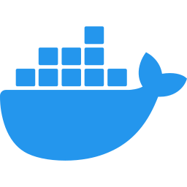
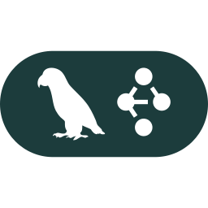
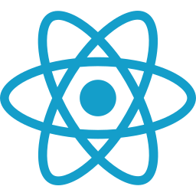
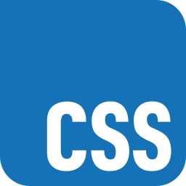
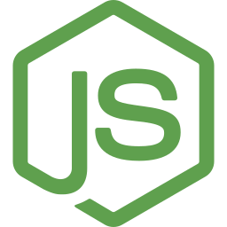


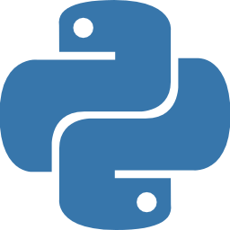







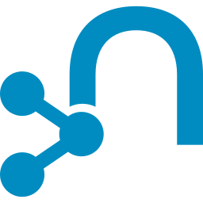
TECH
UDAAN
TECHNICAL APPROACH
Docker — containerized services
1
2
3
4
Frontend Layer
Backend
Model Orchestration
Workflow
React
CSS
Node.js
JWT
bcrypt
Python
FastAPI
LangGraph
Auth tokens
Pwd hashing
Create agent workflow
UI rendering
UI styling
API server
Core logic
REST API
Database
MongoDB
Memory Layer
Cache
User & app data
Redis / Valkey
mem0
Ollama — Local Models
Memory manager
Fast caching
Ollama
Safe code execution
Sandbox
Self-hosted LLM inference
Execution
Qdrant
Neo4j
Vector search
Graph relations
Flow: ① Frontend → ② Backend + MongoDB → ③ Model Orchestration (pulls context from Memory Layer) → Memory Layer ↔ Ollama models → ④ Output Evaluation re-checks via Ollama → result returns to Backend → Frontend. Sandbox runs agent tool-calls via Redis/Valkey and feeds results back to Ollama.

Slide 4




TECH
UDAAN
FEASIBILITY AND VIABILITY
Feasibility
Use Cases
Proven Technology – Multi-agent orchestration, open-weight LLMs, RAG and Graph AI are production-ready technologies.
On-Premise Ready – Dockerized AI services enable secure deployment in private/air-gapped industrial environments.
Seamless Integration – REST APIs, Qdrant, Neo4j and modular AI services support integration with existing enterprise systems.
Scalable Architecture – Model-agnostic design allows deployment from lightweight local models to high-performance enterprise models.
Intelligent Document Analysis – Analyse SOPs, manuals, reports and engineering documents.
Multimodal Inspection – Analyse equipment images, diagrams and technical documents using vision models.
Predictive Knowledge Assistance – Combine RAG + Neo4j graph memory for contextual equipment insights.
Automated Industrial Workflows – Multi-agent planning, analysis, verification and report generation.
Supporting Facts for Feasibility & Viability
Viability
Agentic AI Maturity: Frameworks such as LangGraph/LangChain provide proven orchestration for multi-agent workflows, tool calling, memory and human-in-the-loop validation.
RAG + Graph AI: Vector databases + Neo4j Graph Memory enable both semantic document retrieval and relationship-based reasoning across complex industrial knowledge.
Containerized Deployment: Docker-based microservices allow LLM, RAG, vision, orchestration and databases to be deployed independently and scaled according to available infrastructure.
Industrial Applicability: On-premise AI is particularly suitable for oil & gas, manufacturing, power and critical infrastructure, where confidential operational data cannot freely leave the enterprise network.
Strong ROI – Reduces manual analysis, operational overhead and maintenance effort through AI-assisted workflows.
Operational Efficiency – Multi-agent automation accelerates document analysis, decision-making and knowledge retrieval.
Data Sovereignty – Sensitive industrial data remains within the organization's infrastructure with no mandatory cloud dependency.
Future-Ready Platform – Modular architecture supports new models, agents, tools and industrial use cases without redesigning the system.

Slide 5







TECH
UDAAN
IMPACT AND BENEFITS
Challenges
Impacts
Enforced Governance:
Role-based compliance
Hardware Constraints – Large multimodal models require high compute and memory resources.
Data Quality – Inconsistent/legacy industrial documents can reduce RAG and AI accuracy.
Integration Complexity – Connecting multiple enterprise systems, agents and data sources requires standardized APIs.
Model Reliability – AI outputs require validation, monitoring and human oversight for critical industrial decisions.
Data Sovereignty:
Operational Efficiency:
Data stays internal
Automated inspection workflows
Zero External Lock-In:
No 3rd-party dependency
Air-Gapped Data Security:
Solutions
Fully air-gapped
Model Optimization – Use quantized open-weight models and hardware-aware model routing.
Data Pipeline – Automated preprocessing, validation, chunking and metadata enrichment before indexing.
Modular Integration – Dockerized microservices with REST APIs and standardized interfaces.
Human-in-the-Loop – Agent verification, source citations, confidence scores and audit logs for critical outputs.
Benefits
Accelerated Operations
Minutes, not days
Reduced Costs
Centralized Orchestration
No API fees
Single glass cockpit

Slide 6
TECH
UDAAN
RESEARCH AND REFERENCES
Research References
AgrospAI: A Data Space for Sovereign Data Sharing and On-Demand AI Services in Agriculture https://www.sciencedirect.com/science/article/pii/S0168169926007866
Global Health Suffers When Corporate AI Sovereigns Reign https://www.sciencedirect.com/science/article/pii/S2589750026000920
A Federated Observability Architecture Pattern for Reliable Agentic AI Software Systems Across the AI Software Development Lifecycle (FOAP) https://www.sciencedirect.com/science/article/pii/S0950584926002491
Maintenance Agentic AI for Industrial Operations and Decision Support https://www.sciencedirect.com/science/article/pii/S0360835226004869
Multimodal Dynamic Feature Fusion Framework for Human–Robot Audio-Visual Interaction in Complex Construction Conditions https://www.sciencedirect.com/science/article/abs/pii/S0926580526001925
Differentially Private Data Augmentation via LLM Generation with Discriminative and Distribution-Aligned Filtering https://www.sciencedirect.com/science/article/pii/S0893608026001309
Technical References
ChatGPT - OpenAI ChatGPT Claude AI - Claude AI
YouTube - YouTube Udemy - Udemy
React Documentation - React Docs Node.js Documentation - Node.js Docs
Python Documentation - Python Docs Docker Documentation - Docker Docs
Ollama Documentation - Ollama Docs Lang Graph Documentation - LangGraph Docs
Neo4j Documentation - Neo4j Docs Agentic Automation (IBM) - IBM Agentic Automation
Qdrant Vector Database Documentation - Qdrant Docs
Open-Source LLM Models for Local Deployment - Hugging Face - Run LLMs Locally
Cloud Servers vs Physical Servers - Hugging Face - Cloud vs Physical Servers
COMPARISION TABLE
Feature | Existing AI Solutions | Our Sovereign AI
Model Selection | Vendor-locked models | Multi-model router
Agentic Workflow | Single-task workflows | Multi-step orchestration
Knowledge Retrieval | Cloud/internet-based | Local RAG (Qdrant)
Graph Memory | Not available | Neo4j graph memory
Multimodal Analysis | Mostly text-only | Vision + OCR + P&ID
Tool Execution | Limited tooling | Secure sandbox tools
Output Generation | Text/chat only | Reports, code, diagrams
Vendor Dependency | High vendor lock-in | Open-weight, self-hosted
Data Leaving Org | Persistent egress risk | Zero data egress
Data Privacy | Cloud-processed data | Fully on-premise

